Slide 1
Information Visualization Session 3: Understand Your Story

Slide 2
Speaker
Matthias Shaprio
@politicalmath

Slide 3
Agenda
Refine the question based on data
Data visualization styles
Technology and algorithms

Slide 4
refine the question based on data

Slide 5

Work Your Way To The Question
The question primes your viewer
Visualizations don’t exist on their own
David McCandless
http://informationisbeautiful.net

Slide 6
The Question Will Drive the Visual Style
Size – Comparing similar values
Color – comparing disparate values
Location – Values related to places
Networks – connections between entities
Time – values changing over time

Slide 7
data visualization styles

Slide 8
Applying a Visual Metric
Size
Color
Location
Networks
Time

Slide 9
Visual Metric - Size
5
1
100

Slide 10
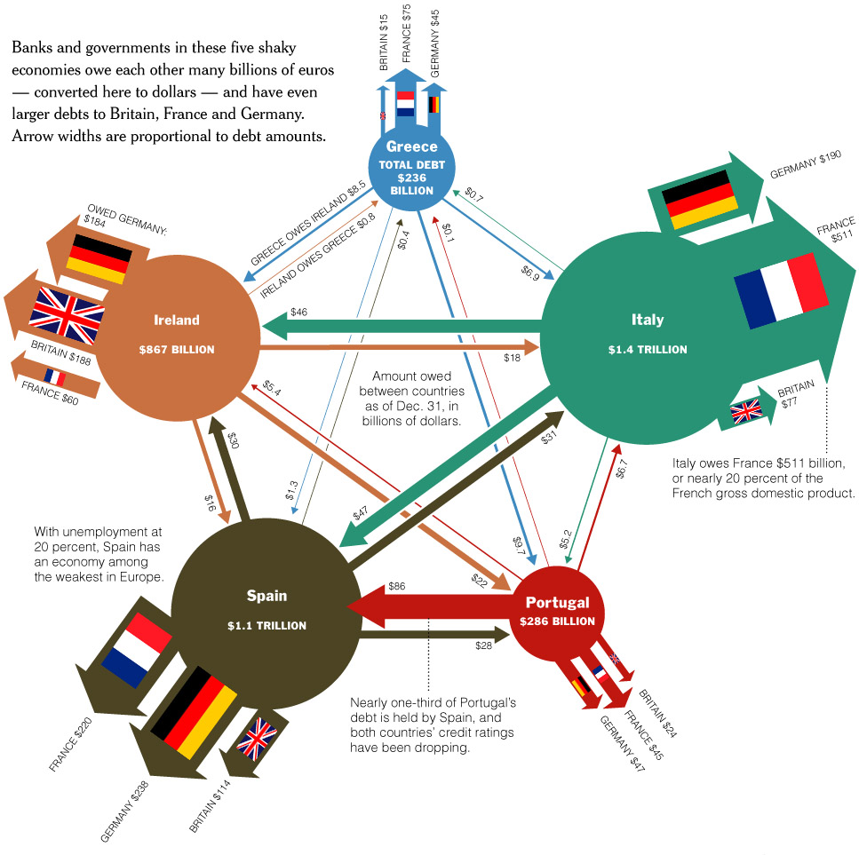
Visual Metric - Size

Slide 11
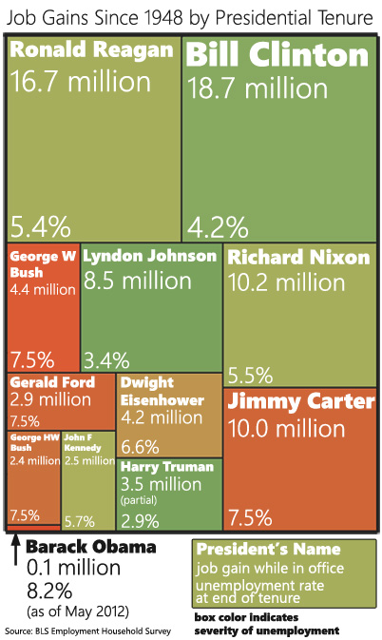
Ways to Show Size
Area (rectangles or circles)

Slide 12
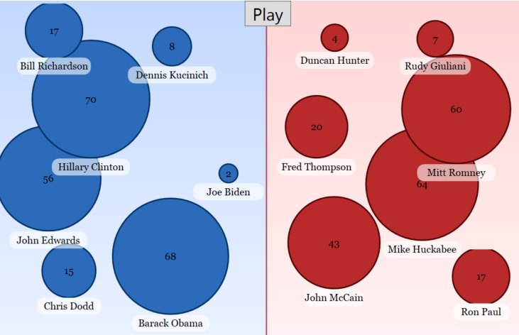
Ways to Show Size

Slide 13
Size tools
Any graphic software (Excel)
Algorithmic calculations from Session 1
Excel Helpers

Slide 14
Visual Metric – Color
0
50
100

Slide 15
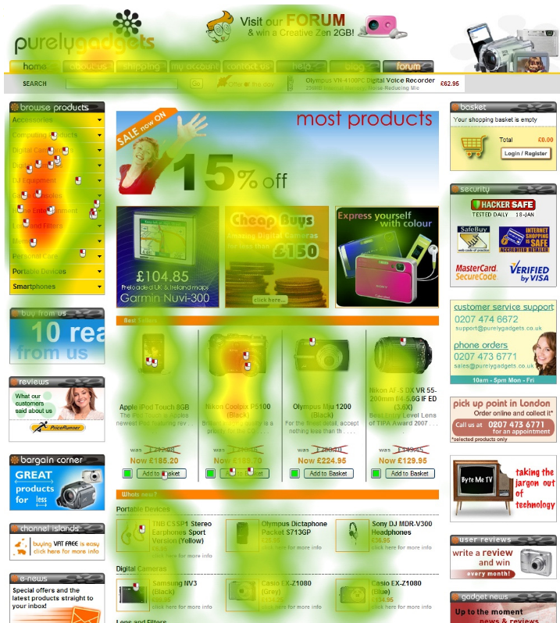
Visual Metric – Color
Gradient colors
Red-yellow-green
Red-blue
Shaded (light-to-dark)

Slide 16
Picking the right range
53
Not good for data with subtle value variation
46
Colors can wash out or change depending on display
0
100

Slide 17
Picking the right range
Not good for data with subtle value variation
53
Colors can wash out or change depending on display
46
40
60

Slide 18
Picking the right range
Not good for data with subtle value variation
53
Colors can wash out or change depending on display
46
40
60

Slide 19
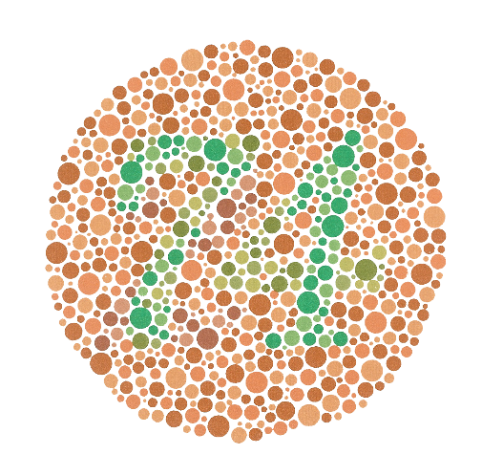
Picking the right range
4-5% of viewers are colorblind
0
50
100

Slide 20
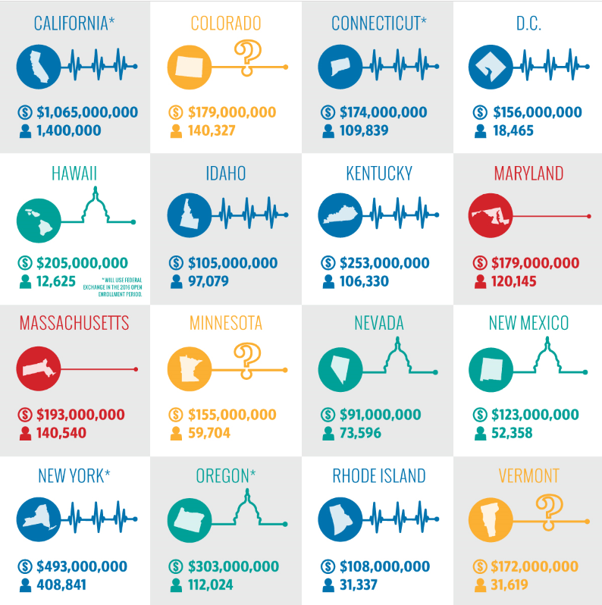

Visual Metric – Color
Color “buckets”
http://dailysignal.com/2015/06/08/how-the-16-state-exchanges-are-faring-under-obamacare/

Slide 21
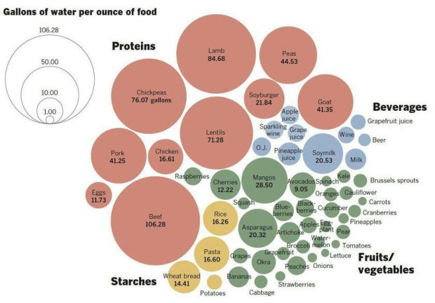
http://flowingdata.com/2015/04/07/gallons-of-water-to-produce-foods/

Slide 22
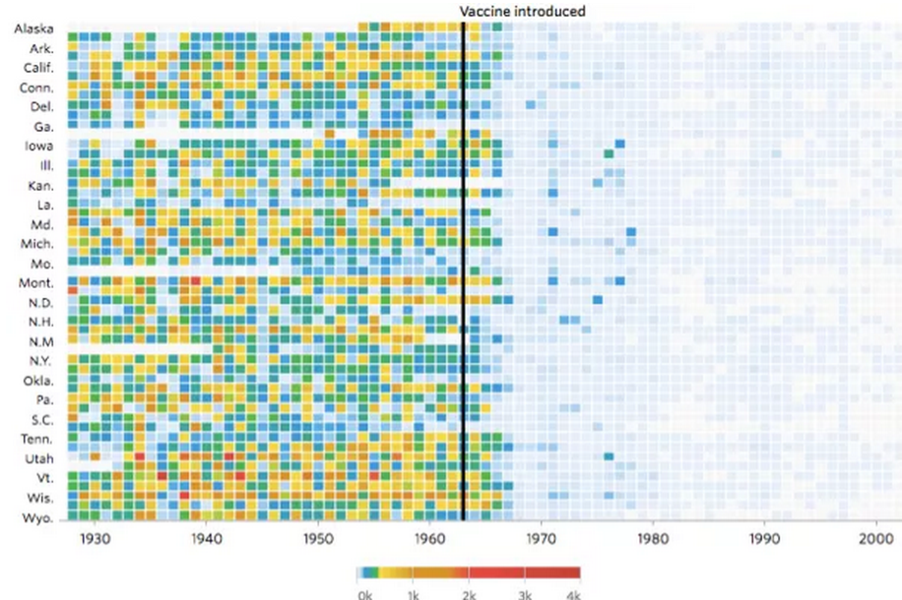
http://graphics.wsj.com/infectious-diseases-and-vaccines/

Slide 23
Color Metric Tools
List of color tools
Excel helper

Slide 24

Visual Metric - Locations

Slide 25
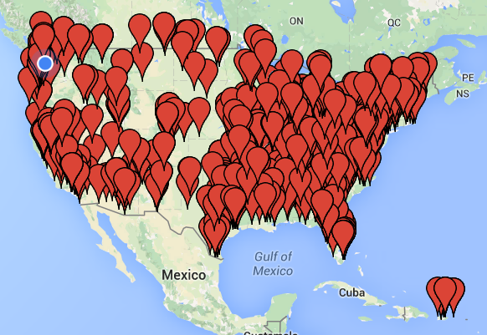
Visual Metric - Locations
Google Maps makes mapping latitude/longitude data points simple

Slide 26
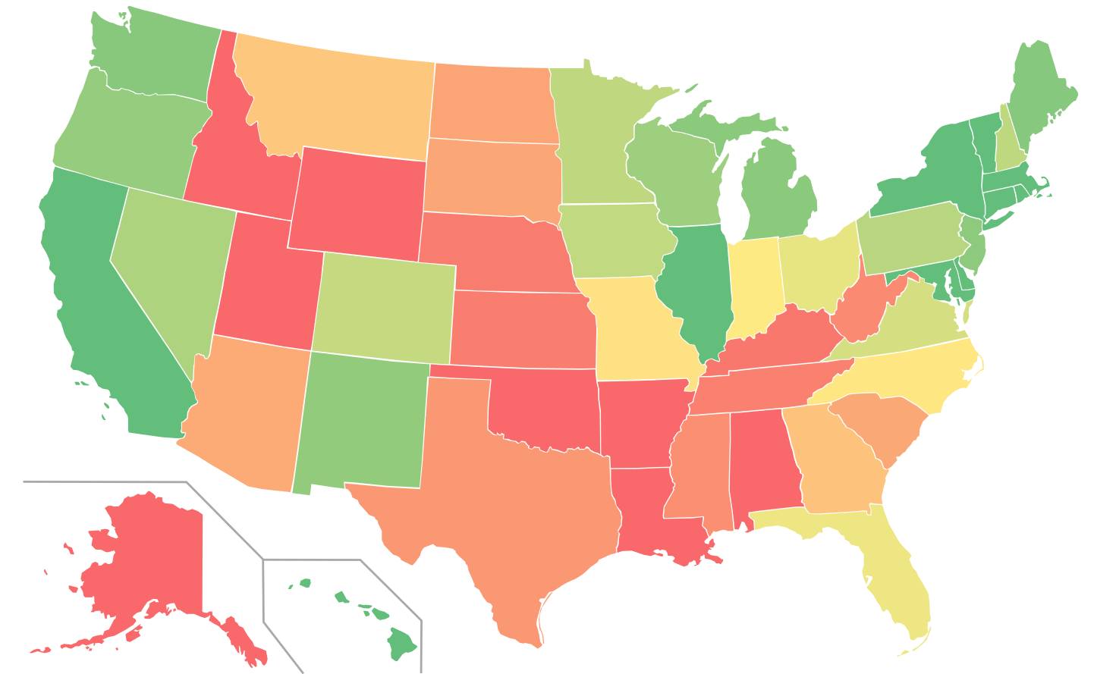
Visual Metric - Locations
Choropleth map

Slide 27
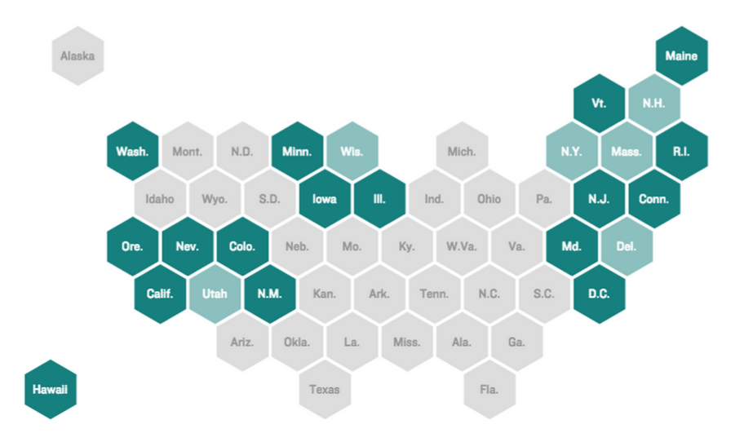
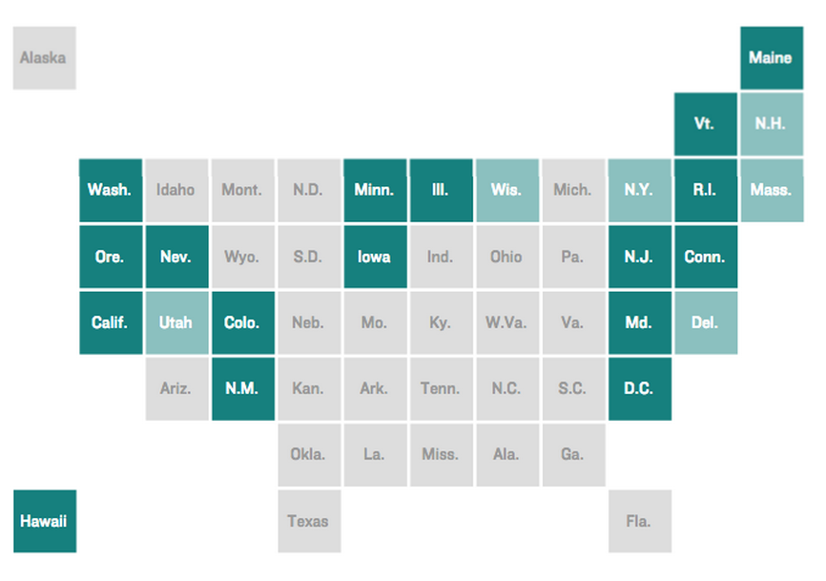
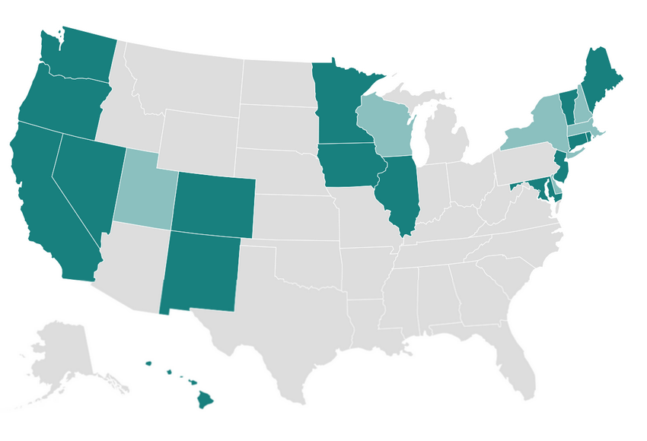
Visual Metric - Locations
http://blog.apps.npr.org/2015/05/11/hex-tile-maps.html

Slide 28
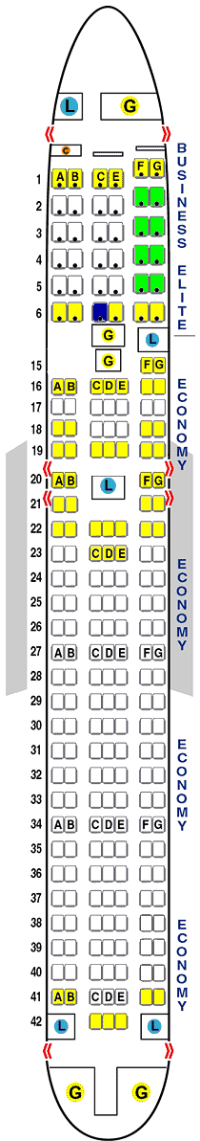
Visual Metric - Locations
Data mapped to any corresponding physical dimension
http://seatguru.com

Slide 29
Google Maps Demo

Slide 30




Visual Metric - Networks

Slide 31
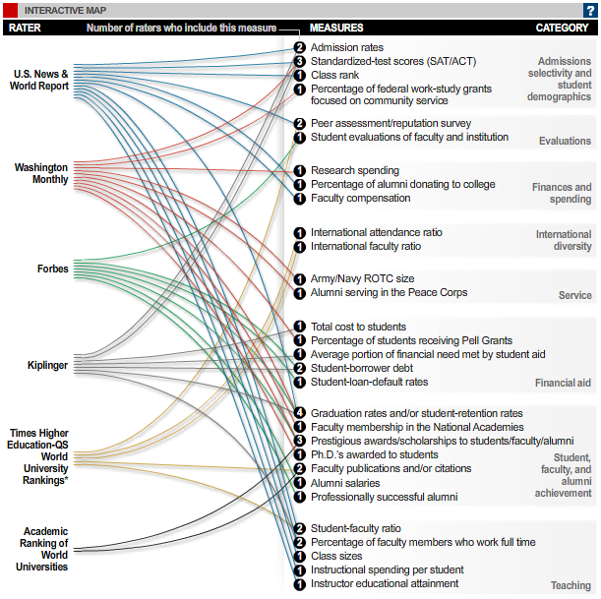
Visual Metric - Networks
Show connections between data points based on some true/false statement

Slide 32
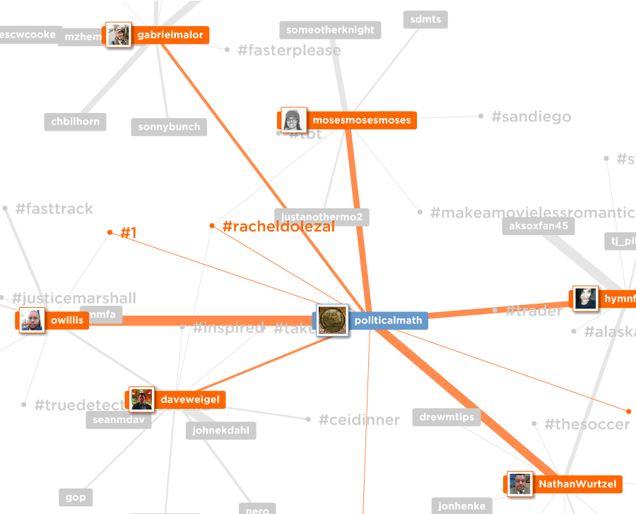
Visual Metric - Networks
force directed graph drawing
mentionmapp.com

Slide 33
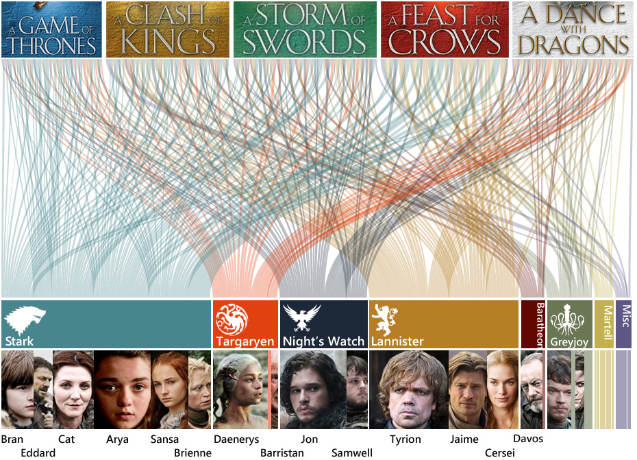
Visual Metric - Networks

Slide 34
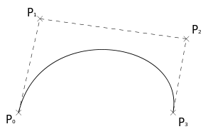
Visual Metric - Networks
Creating a bezier curve for networking visuals
x1,y1 – start point (P0)
x2,y2 – control point 1 (P1)
x3,y3 – control point 2 (P2)
x4,y4 – end point 1 (P1)

Slide 35
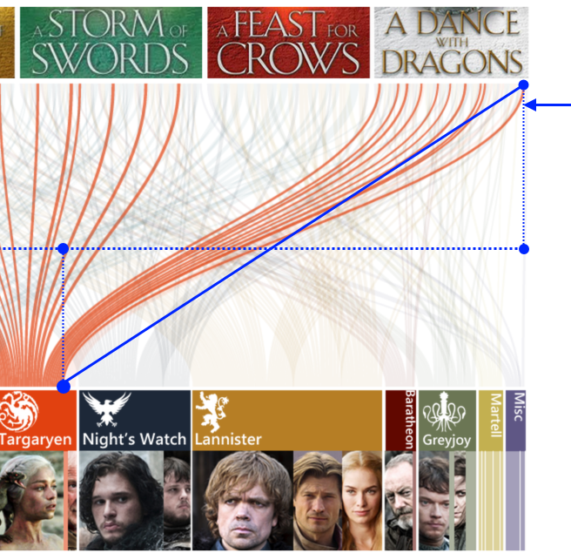
Visual Metric - Networks
Creating a bezier curve for networking visuals

Slide 36
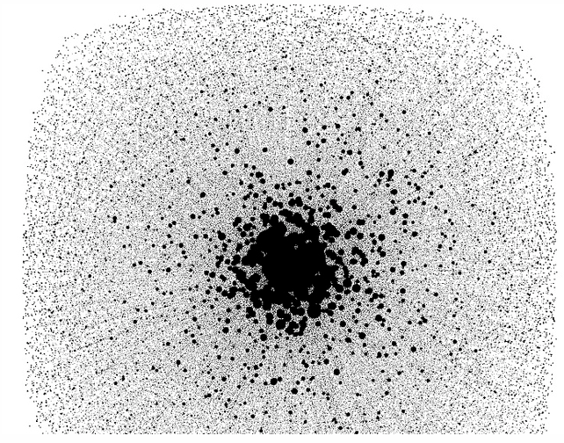
Visual Metric - Networks
limited when data set becomes too large
(1000’s of data points)

Slide 37
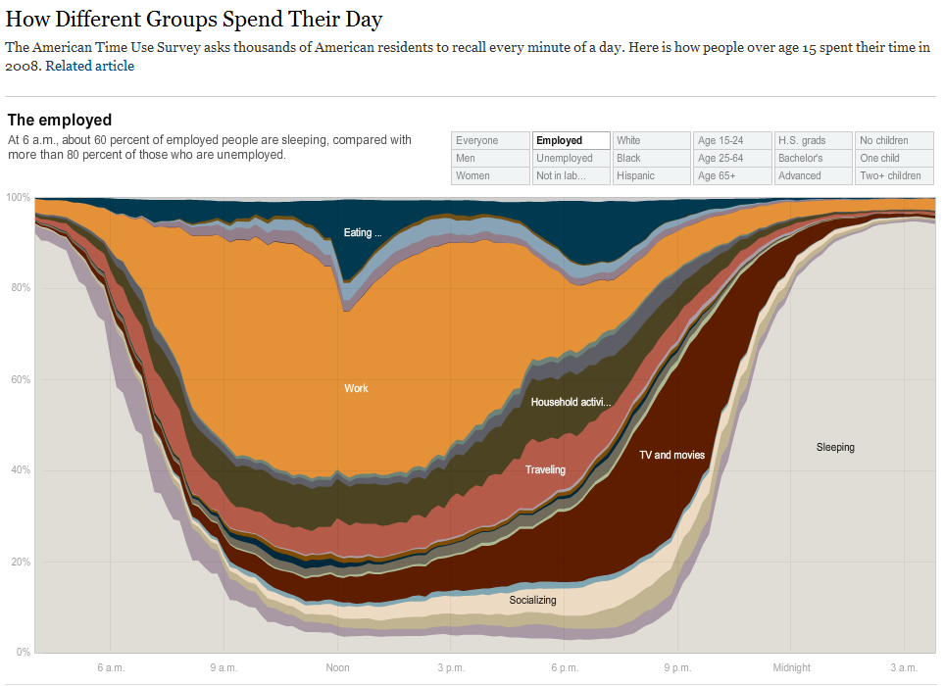
Visual Metric - Time
Data over time, expanded or contracted

Slide 38
Visual Metric - Time
Using animations to expand or contract time

Slide 39
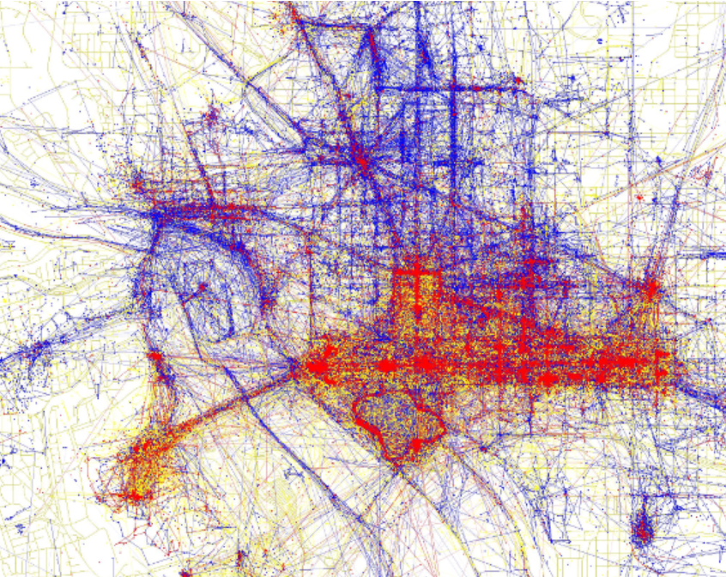
Using Multiple Metrics
Layering visual metrics to create multiple dimensions of meaning
https://www.flickr.com/photos/walkingsf/sets/72157624209158632/

Slide 40
technology and algorithms

Slide 41
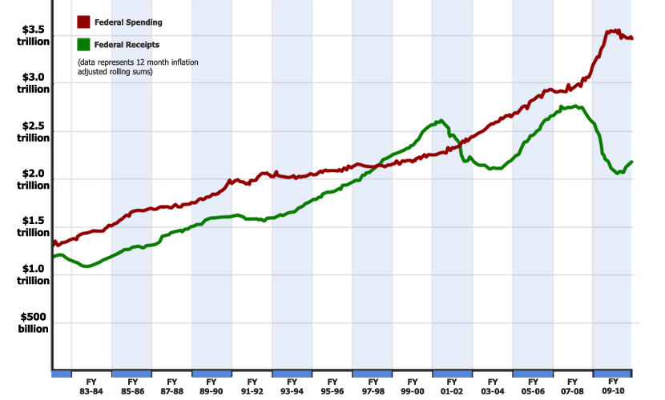
Excel + Photoshop
Create charts in Excel
Manipuate in Photoshop or Paint.NET (Windows)
or Gimp (Windows/Mac)

Slide 42
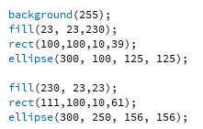
Processing
basic visual programming

Slide 43

Processing
created by Ben Fry, visualization pioneer
All examples from Visualizing Data are included

Slide 44
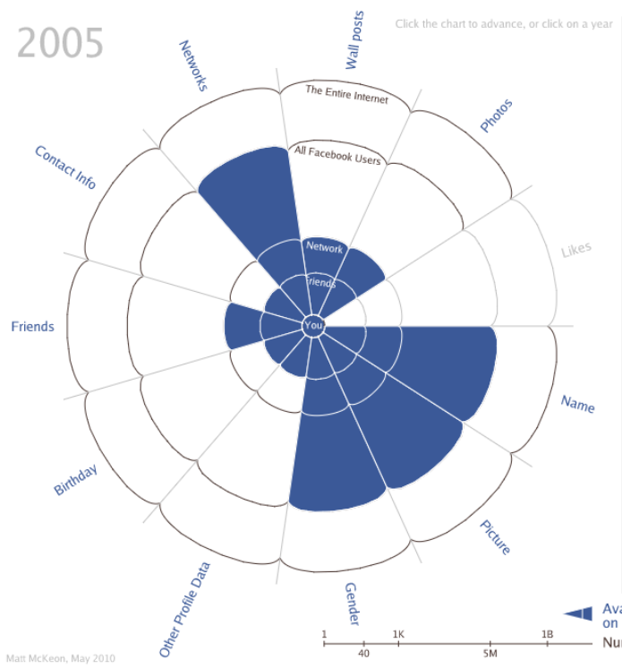
Processing.js
like Processing, but can be viewed on the web
Evolution of Facebook Privacy Matt McKeon

Slide 45
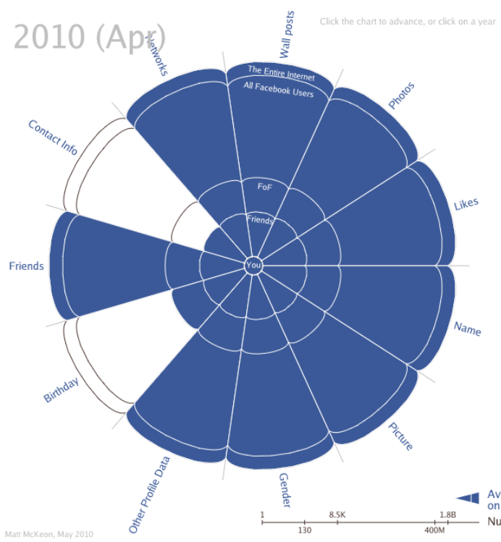
Processing.js
like Processing, but can be viewed on the web
Evolution of Facebook Privacy Matt McKeon

Slide 46

Processing.js
Khan Academy
https://www.khanacademy.org/hourofcode

Slide 47
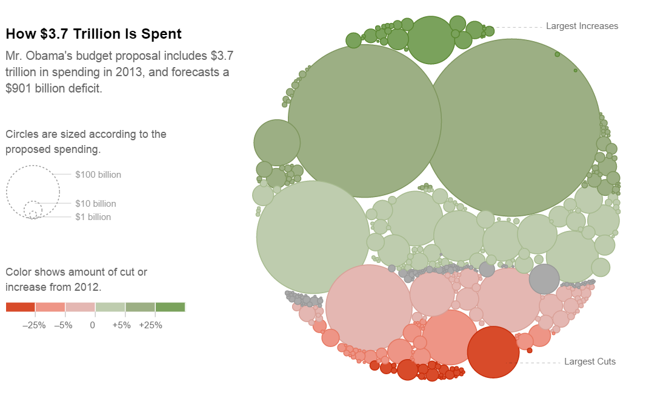
d3.js
Javascript library for visualization
Used by New York Times visualization team
Powerful but complex

Slide 48
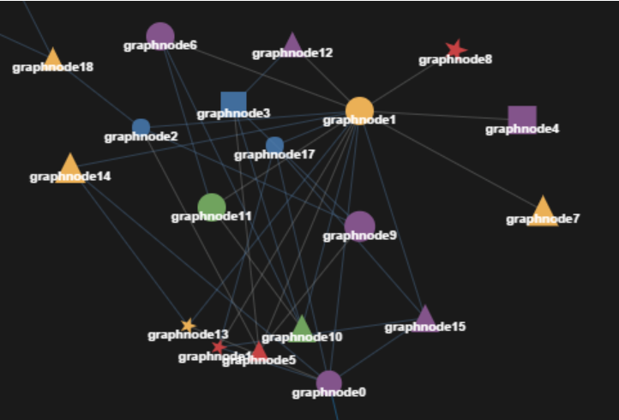
Javascript InfoVis Toolkit
Javascript library for visualization
Used by New York Times visualization team
Powerful but complex

Slide 49
Lab 3
Explore data with Excel charts
Excel helpers for color visualization
Google Maps for mapping vis

